Slide 1


DE GRUYTER
NCSC 2022

Slide 2


About De Gruyter
As an independent academic publisher De Gruyter has been dedicated to disseminating excellent scholarship since 1749. Today, we remain true to our founding spirit, yet also have ambitious plans for the future. Thanks to our proactive embrace of digital transformation, our cutting-edge research is reaching an ever-broader global audience.
Each year, we publish 1,300 new books, 900 journals, and highly valued databases across the humanities, social sciences, law, and STM.
Angebot Shooting
Hr. Buhr angefragt bei Kerstin Müller

Slide 3








What We Publish
Books
Journals
Databases & Online Reference Works
We publish more than 1,500 books each year, across all academic disciplines, both in print and ebook formats.
Our portfolio contains some 430 subscription and open-access academic journals, available in print and digital formats.
Journals
Books
Databases & Online Reference Works
We offer some 70 databases and online reference works, covering an extremely broad spectrum of disciplines, from archeology to zoology.

Slide 4
Our Subject Areas
Science, Technology, Medicine (STM)
Arts and
Architecture Group
Humanities and Social Sciences
Asian and Pacific Studies
Library and Information Science, Book Science
Chemistry
Architecture
Business and Economics
Computer Sciences
Design
Linguistics and Semiotics
Classical and Ancient Near Eastern Studies
Engineering
Arts
Literary Studies
Geosciences
Cultural Studies
Music
Industrial Chemistry
History
Philosophy
Life Sciences
Islamic and Middle Eastern Studies
Social Sciences
Materials Sciences
Theology and Religion
Jewish Studies
Mathematics
Law
Medicine
Pharmacy
Physics

Slide 5









Our Book Portfolio
1,500
+3,500
29
2008
1749
New publications
each year
Published open access books
Subject
areas
First ebook publication
First book publication
115,000
+2,400
+50,000
2014
eBooks on
degruyter.com
New publisher partner titles each year
Backlist books
All titles available in ePUB format since 2014
Figures current to May 2021

Slide 6




Our Journal Portfolio
330
100
600
60
Subscription
journals
Open Access journals
Sciendo journals*
Annual journals
+…
As well as the journal titles of our publisher partners
* Sciendo is a De Gruyter company that provides open access publishing services to associations and individuals.

Slide 7
Journal Portfolio
700+ open access
journals*
330+ subscription
journals
30+ publisher partner
journals
*including 600 Sciendo journals

Slide 8
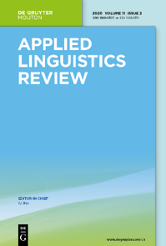

Top Journals
We publish numerous high-impact journals with an excellent reputation in their respective disciplines.

Slide 9

Journal Collections
Scholars Plus
Research Now
304 titles
22 subject areas
58 titles
11 subject areas
Custom Collections
Journal Archive
Databases & Online Reference Works
Law
Medical
193 years of research
318 journals
5 million pages of content
We offer some 70 databases and online reference works, covering an extremely broad spectrum of disciplines, from archeology to zoology.

Slide 10


A Leader in Open Access
    De Gruyter is actively driving the transformation of its journal portfolio
    We offer some 100 OA journals, 75% of which use the APC model, and 25% of which are Platinum OA.
    Over 30 of our subscription journals have been migrated to open access.
    Some 15 transformation agreements, mainly in Europe, provide authors free publication of OA articles in our subscription journals.
    Subscribe-to-open (S2O) is being testing as an alternative transformation model for HSS journals.

Slide 11





A Leader in Open Access
    Our OA book portfolio has grown continuously since 2010.
    With more than 3,500 OA books on degruyter.com, we are one of the world's largest independent providers of OA books.
    We have established numerous OA series with renowned partners and research institutes worldwide.
    We have developed new OA funding strategies, including collaborative funding models.
Involvement
    De Gruyter is Member of the Open Access Scholarly Publishing Association (OASPA) and a Sponsor of the Directory of Open Access Books (DOAB).

Slide 12
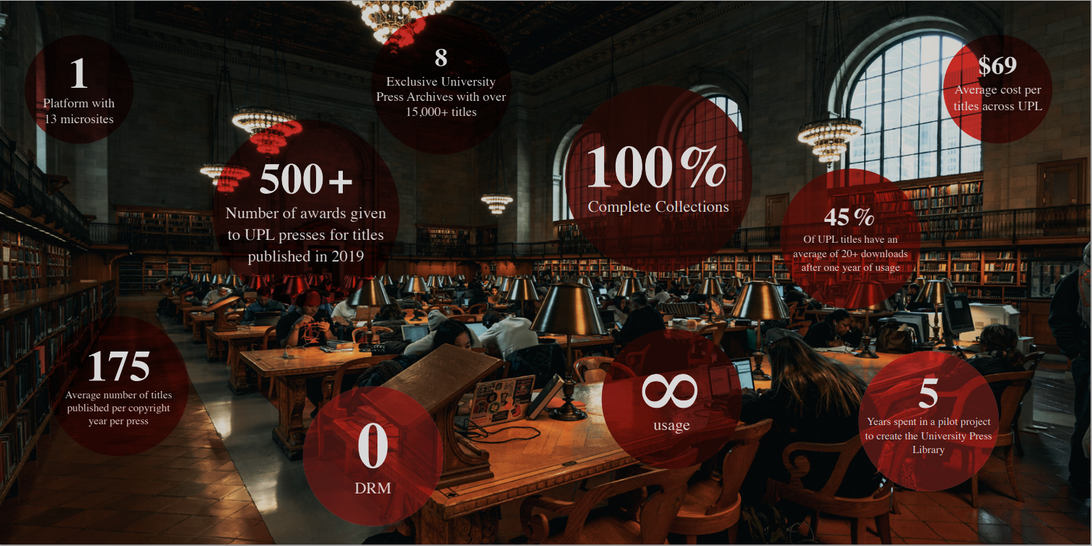
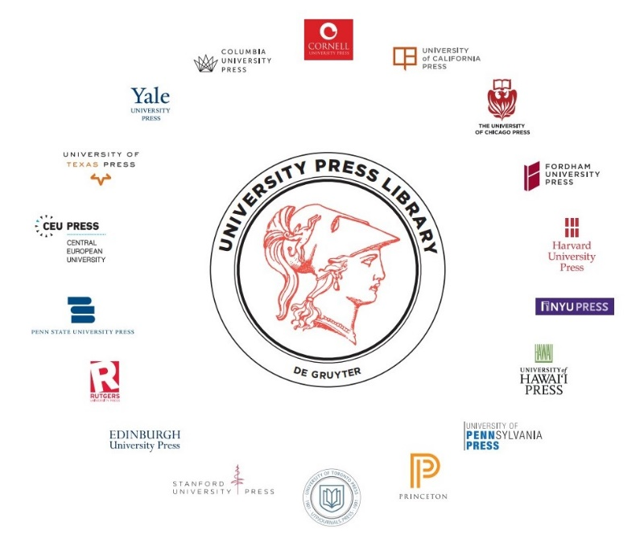
University Press Library
Program
Notes:
Comprehensive coverage of annual output sold as collections by copyright year
Deeply discounted
All titles are free of Digital Rights Management
DOIs and MARC records are available for all ebooks
Soon-to-be-released ‘De Gruyter Data’ librarian’s portal for easy management of purchased content

Slide 13
De Gruyter’s University Press Library (UPL) Program 1/2
  De Gruyter’s University Press Library (UPL) provides libraries the option of purchasing the complete front-list of books published by 19 prestigious university presses, all under a multi-use DRM-free license.
  This level of digital availability and accessibility is unrivaled by other sources of university press content.
  The University Press Library started out in 2014 as a pilot project, with three university presses and 10 participating libraries. University presses were assigning digital rights to their eBooks unevenly by title and by vendor (a practice that continues today), which was frustrating for libraries where content was needed by patrons in digital format and without restrictions.

Slide 14
De Gruyter’s University Press Library (UPL) Program 2/2
  Titles that are ‘single-user only’ on other platforms, when available at all in digital format, are included in the University Press Library on the De Gruyter platform.
  This content is provided in press-specific collections from copyright years 2014 to 2022+ on the De Gruyter platform.
  The high value and prestige of the content of our publisher partners demands full digital accessibility to meet the expectations of faculty and students. This is only possible with a sustainable business model that removes restrictions to electronic formats and serves the mission of the library.
  This is the goal of our University Press Library.

Slide 15
New and Upcoming Developments
Launched new platform in November 2021
Partnership with LibLynx
New VPAT
Improved delivery of MARC records and strengthened relationships with discovery services
New Librarian’s Portal to be launched prior to ALA summer
Added 4 new presses. Central European, Edinburg, U of Hawaii, and U of Texas
Created the University Press Library Cooperative

Slide 16
Thank you!
degruyter.com

